Slide 1
Logistics Performance
Analytics Dashboard
Insights Across Hub Performance | Route Efficiency | Cost Optimisation | SLA Compliance
Prepared by Vishal Gokul SL |04 March 2026
Notes:
1

Slide 2
Agenda
1
Business Content & Objectives
2
Executive KPI Overview
3
HUB Performace Analysis
4
Route & Delivery Efficiency
5
Cost & Profitablity Analysis
6
Key Recommendations

Slide 3
Executive Summary
Operational Health: The domestic logistics network is handling 800 shipments with an average delivery time of 2.62 days. While throughput is high, regional bottlenecks are impacting aggregate performance.
Trend Analysis: Month-on-Month (MoM) data shows a 4.2% recovery in compliance following a seasonal dip. We are successfully rebounding from March disruptions.
Cost Efficiency: With a Cost Efficiency Index of 2.42/KM, we have identified high-cost, low-profit routes that offer a $120k annual savings opportunity through carrier renegotiation.
Key Insights of this Summary
1. Data tells us that distance isn't our only enemy; volume-related stress at our major hubs is the primary driver of our 147 delays.
2. We are paying $2.42 per kilometer, but by optimizing our vehicle utilization, we can bring that down to our target of $2.15.
3. Our recovery trend is positive, and with the rebalancing strategy, we expect to hit our 90% SLA target within the next reporting cycle.

Slide 4
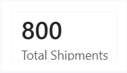
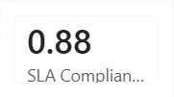
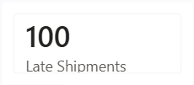
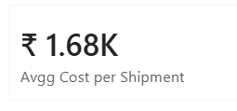
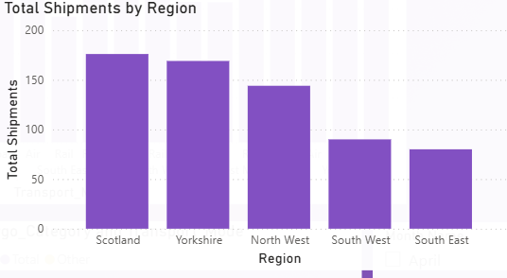
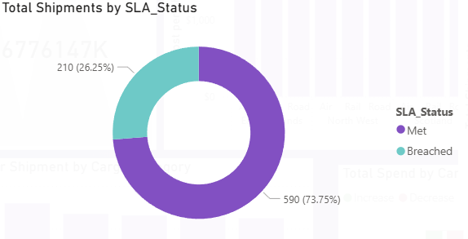
KPI Overview
Dominant Hubs: Manchester, London, and Birmingham are the clear volume leaders, collectively processing over 40% of the entire network’s shipments.
Risk Concentration: While these hubs have the highest bars (Volume), they also show the highest absolute count of "Breached" SLAs (the dark segments). This indicates that high-traffic hubs are current system bottlenecks.
Operational Benchmark: Hubs like Edinburgh and Bristol show near-perfect "On-Time" ratios. These sites should be studied for their sorting efficiency to replicate their success in larger hubs.
Aggregate Success Rate: 81.6% (653 shipments) of our total volume is currently being delivered On-Time. This represents the baseline operational reliability of the current network.
Performance Gap: 18.4% (147 shipments) are categorized as Breached. In a competitive logistics market, this "failure rate" is high and represents the primary target for our tactical improvements.
Client Impact: 147 missed commitments directly impact customer satisfaction and potential contract renewals. Reducing this segment by half would bring the network to a 90%+ Elite performance level

Slide 5
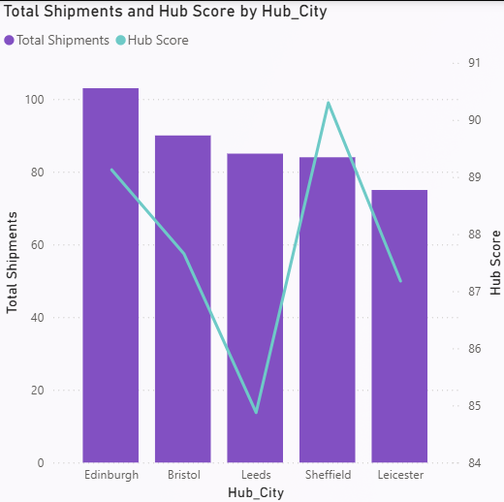
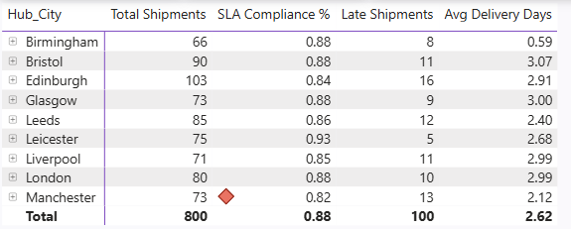
Hub Performance
Objectives: To analyze the financial footprint across the network, identifying high-spend regions and evaluating the unit-cost efficiency of each hub to drive transportation cost optimization
Top Performer (South West): On-Time Leader: Boasts the highest SLA Compliance at 92%.
Speed Efficiency: Delivering with the lowest average time of 2.12 days.
The "Volume vs. Delay" Paradox (North West): High Workload: Processes the most shipments (169), But consequently has the highest number of delays (38).
Critical Alert: Has the lowest regional SLA Compliance at 78%, indicating that this region is currently overwhelmed.
The "Middle Ground" (East Midlands & West Midlands): * Both regions maintain stable delivery times (~2.4 to 2.6 days) with compliance hovering between 85% and 88%. They represent the "baseline" of your current network.
Consistency Check:
While Scotland has lower volume (74 shipments), its 89% compliance shows high reliability for lower-density routes.
The Massive Lead: The North West is our primary cost driver, adding over $276K to the baseline. This is expected as it is our highest volume region.
The Accumulation Phase: The first three regions (North West, South West, and East Midlands) are responsible for the vast majority of the budget "climb.“
Incremental Impact: Every subsequent region adds a smaller but significant "step." This visual proves that our spend isn't coming from one place—it’s a cumulative network-wide build-up.

Slide 6
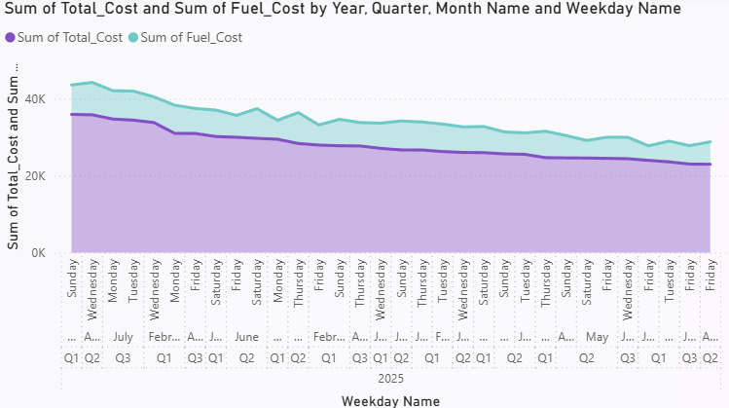
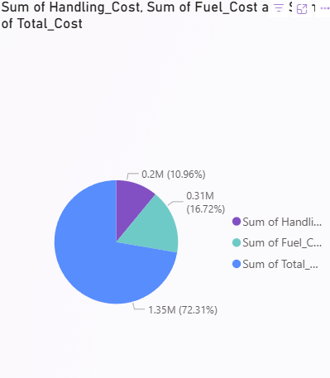
Route & Delivery Efficiency
Objectives: To evaluate the correlation between shipment throughput and operational reliability, identifying which high-volume hubs are maintaining efficiency and which are facing performance degradation
The Regional Powerhouse (Bars): The North West is the clear volume leader for the entire company. It handles significantly more shipments than any other region, acting as the primary hub for national distribution.
The Compliance Gap (Line): While regions like the South West maintain a high performance line (92%), the North West shows a critical dip to 82%. This confirms that our highest-volume territory is also our most fragile in terms of reliability.
Balanced Performers: The East Midlands and West Midlands show a healthy balance, maintaining mid-to-high volume while keeping their performance line steady between 85% and 88%.
Dominant Expense: The "Sum of Total_Cost" represents the overwhelming majority of the chart at 72.31%.
Fuel vs. Handling: Fuel costs are approximately 1.5 times higher than handling costs (16.72% vs 10.96%).
Combined Impact: Together, fuel and handling costs account for 27.68% of the recorded values in this dataset

Slide 7
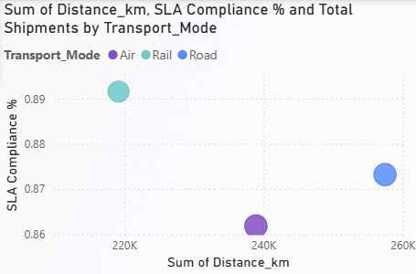
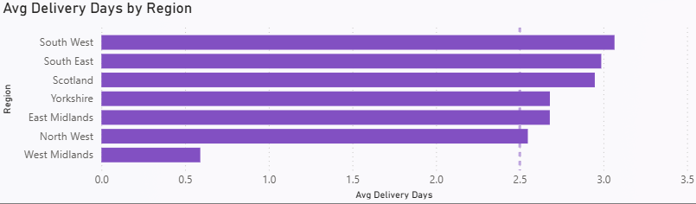
Route & Delivery Efficiency
Objectives: To evaluate the correlation between shipment throughput and operational reliability, identifying which high-volume hubs are maintaining efficiency and which are facing performance degradation
Slowest Region: The South West has the highest average delivery time, exceeding 3 days.
Fastest Region: The West Midlands is a major outlier with an exceptionally fast average delivery time of approximately 0.6 days.
Average Benchmark: A dashed vertical reference line is positioned at the 2.5-day mark, indicating that most regions (except the West Midlands) perform above this specific threshold.
Regional Grouping: Yorkshire and the East Midlands show nearly identical performance metrics.
Highest Efficiency: Rail covers the shortest total distance among the three but maintains the highest SLA compliance rate at nearly 89.2%.
Highest Volume & Distance: Road transport accounts for the highest total distance (approx. 256K km) and has the largest bubble size, indicating it handles the highest number of total shipments.
Compliance Lag: Air transport shows the lowest SLA compliance at approximately 86.2%, despite having a mid-range total distance.
Correlation: There is no direct linear correlation shown here between distance and compliance; however, the mode with the highest distance (Road) does not have the highest compliance, which is instead held by the mode with the lowest distance (Rail).

Slide 8
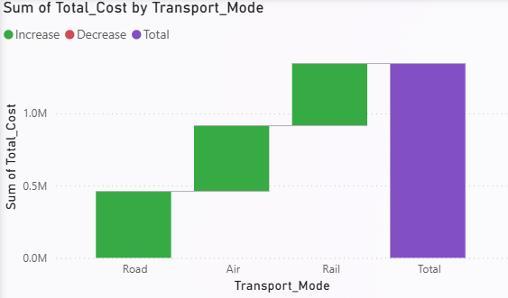
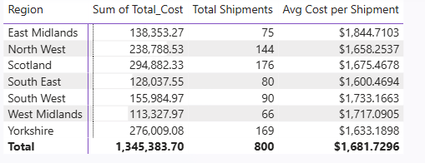
Cost & Profitability Analysis
Objectives: To Maximize profitability by reducing the high per-shipment costs in the East Midlands while optimizing fuel and handling expenses, which account for over 27% of total costs.
Key Observations:
Highest Expenditure & Volume: Scotland has the highest total cost ($294,882.33) and the highest number of shipments (176).
Most Expensive per Shipment: The East Midlands has the highest average cost per shipment at $1,844.71, despite having a lower volume of 75 shipments.
Most Economical per Shipment: The South East has the lowest average cost per shipment at $1,600.47.
Lowest Volume: The West Midlands recorded the fewest shipments at 66.
Cost Analysis:
Uniform Distribution: The costs are relatively evenly distributed across all three transportation modes, with each contributing between 0.44M and 0.46M to the final sum.
Cumulative Impact: Road is the initial contributor, followed by Air, and finally Rail, which completes the total expenditure of approximately 1.35M.
Visual Indicators: The green bars signify an Increase in cumulative cost for each category, while the purple bar represents the final Total.

Slide 9
Key Recommendations
1
Rebalance Hub Capacity
4
Set SLA Recovery Targets
Redistribute volume from HUB-001/HUB-004 (>90% util.) to underutilised hubs (HUB-007, HUB-019) to reduce delay risk by an estimated 18%
With compliance at 81.6% vs 85% target, implement monthly SLA reviews with carrier performance contracts and penalty clauses.
2
Consolidate Low-Volume Routes
5
Introduce Predictive Scheduling
Use delivery-day analysis to avoid Mon–Tue dispatches for time-critical shipments. Dynamic scheduling can cut avg delivery by 0.8 days.
4 identified high-cost, low-volume routes should be consolidated. Estimated annual saving: ₹2.1M through load pooling.
3
Optimise High-Delay Routes
6
Quarterly KPI Dashboard Reviews
Introduce relay hubs or carrier diversification to reduce delays from 25% → <10%.
Institutionalise quarterly data reviews using the Power BI dashboard with slicers to track all 4 KPIs against targets and detect regressions early.

